Slide 1


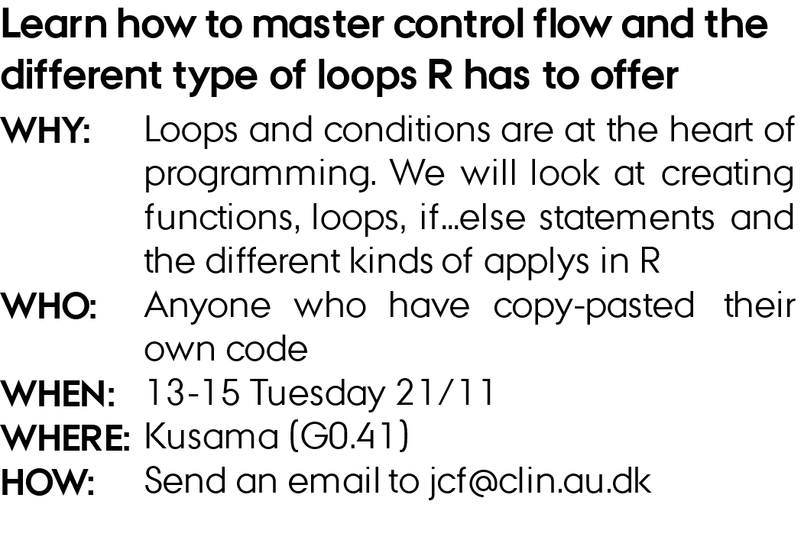
Control flow and loops

Slide 2
outline
Functions
Loops
Control flow
Debugging
Apply

Slide 3
Functions
A function is a set of instructions that performs a specific task.
Defined by using the function() keyword.
myFunction = function(parameter1, parameter2) {
# Function body
# Code to be executed
}
Either returns the last line, or use the return keyword/function
addNumbers = function(a, b) {
result = a + b
return(result)
}
addNumbers = function(a, b) {
return(a + b)
}
addNumbers = function(a, b) {
a + b
}

Slide 4
Functions
Set default values for parameters to make some arguments optional.
powerOf = function(base, exponent = 2) {
result = base^exponent
return(result)
}
Variables created inside a function are local to that function.
x = 10
myFunction = function(y) {
x = 5
return(y * x)
}

Slide 5
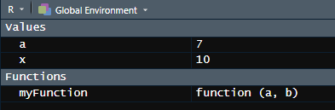
Scope
Where does R look for variables?
myFunction(a, b) {
return(a + b)
}
a and b exist within the function and are destroyed after it returns
Global Environment
x = 10
a = 7
myFunction(1, 2)
myFunction2(a, b) {
return(a + b + x)
}
x is not defined within the scope (function), so R looks at global environment
myFunction2(1, 2)
myFunction3(1, 2)
myFunction3(a, b) {
x = 5
return(myFunction2(a, b) + x)
}

Slide 6
functions
The ... ellipsis in R allows you to create functions that can accept a variable number of arguments.
It's often used when you want to pass additional arguments to other functions within your function or when you want to create functions with flexible argument lists.
concatStrings = function(startString, ..., sep = " ") {
result = paste(startString, ..., sep = sep)
return(result)
}
concatStrings("Hello", "World!", startString = "This is the start:")
"This is the start: Hello World!"

Slide 7
loops
The for loop is used when you know in advance how many times you want to iterate
for (i in 1:5) {
print(i)
}
The while loop is used when you want to iterate until a certain condition is true.
i = 1
while (i <= 5) {
print(i)
i = i + 1 # Increment the counter
}

Slide 8
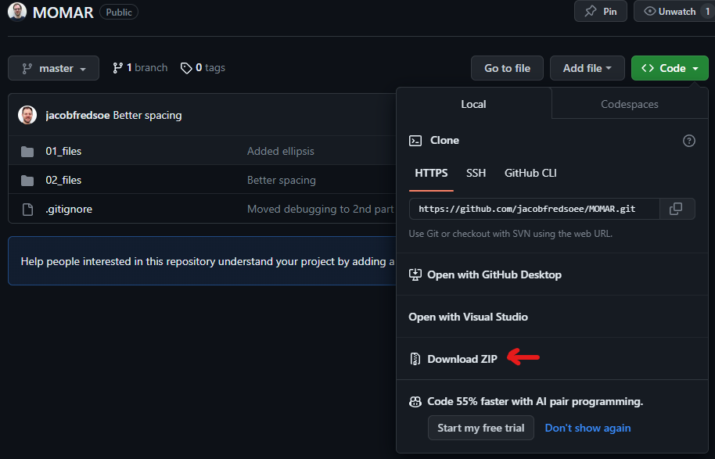
Group task – writing functions
1) git clone https://github.com/jacobfredsoee/MOMAR.git
2) open ./MOMAR/02_files/02_functions_part1.R
3) in small groups, try to write the body of the indicated functions

Slide 9
Control flow
The if statement allows you to execute a block of code based on a specific condition.
myFunction = function(x) {
if(x > 5) {
return("x is greater than 5")
}
}
Alternative, one-liner
myFunction = function(x) {
if(x > 5) return("x is greater than 5")
}
Alternative alternative, one-liner
myFunction = function(x) {
if(x > 5) { return("x is greater than 5") }
}

Slide 10
Control flow
The else statement is paired with the if statement to handle the case where the condition specified in the if statement is false
myFunction = function(x) {
if(x > 5) {
return("x is greater than 5")
} else {
return("x is not greater than 5“)
}
}

Slide 11
Control flow
The else statement is paired with the if statement to handle the case where the condition specified in the if statement is false. If can be paired with else.
myFunction = function(x) {
if(x > 5) {
return("x is greater than 5")
} else if (x == 5) {
return("x is 5")
} else {
return("x less than 5")
}
}
If many conditions, use switch instead
centre = function(x, type) {
switch(type,
mean = mean(x),
median = median(x),
trimmed = mean(x, trim = .1))
}
Is the same as:
centre = function(x, type) {
if (type == "mean") {
return(mean(x))
} else if (type == "median") {
return(median(x))
} else if (type == "trimmed") {
return(mean(x, trim = .1))
}
}

Slide 12
Control flow
The break statement is used to prematurely exit a loop:
for (i in -10:10) {
if (i == 0) {
break # Exit the loop
print(10/i)
}
}
The next statement is used within loops to skip the remaining code for the current iteration and move on to the next one
for (i in -10:10) {
if (i == 0) {
next # Skip this number
print(10/i)
}
}

Slide 13
Control flow
The break statement is used to prematurely exit a loop:
for (i in -10:10) {
if (i == 0) {
stop("i cannot be zero!") # Stops execution and prints the message
print(10/i)
}
}

Slide 14
Group task – writing functions
1) open ./MOMAR/02_files/02_functions_part2.R
2) in small groups, try to write the body of the indicated functions
if: Conditional statement for decision-making in code.
Example: if (condition) { code }
else: Alternative code block for false condition in an if statement.
Example: if (condition) { code } else { alternative_code }
break: Exit a loop prematurely, terminating its execution.
Example: for (i in 1:10) { if (i == 5) { break } }
next: Skip the rest of the current iteration in a loop.
Example: for (i in 1:10) { if (i == 0) { next } }
stop: Halt function execution, generating an error message.
Example: if (error_condition) { stop("Error message.") }

Slide 15
Debugging
What do you do when you get errors?
02_files/02_debug.R

Slide 16
Apply, like for loops, but with storage
A for loop to take the square root of all numbers from 1 to n
result = numeric(length = n)
for(i in 1:n) {
result[i] = sqrt(i)
}
Equivalent sapply:
result = sapply(1:n, sqrt)
result = sapply(1:n, function(i) {
sqrt(i)
})
Remember <<- scopes to global environment
result = numeric(length = n)
result2 = sapply(1:n, function(i) {
result[i] <<- sqrt(i)
return(sqrt(i)^2)
})

Slide 17
All the applys
apply(): Used for operations on matrices/data frames like row or column sums.
Example: geneData %>% apply(1, var, na.rm = TRUE)
sapply() (simplify apply): When you expect the output to be of a simpler structure.
Example: 1:10 %>% sapply(sqrt)
lapply() (list apply): Same as sapply, but you want the output as a list
Example: 1:10 %>% lapply(sqrt)
mapply() (multivariate apply): When you need additional arguments passed
Example: mapply(rep, times = 1:10, x = 1:5, each = 2)
Others: vapply (when you need a specific type return), tapply (something with factors)

Slide 18
Group task – writing more functions
1) open ./MOMAR/02_files/02_apply.R
2) in small groups, try to solve the different problems
apply(): Commonly used for operations on matrices like row or column sums.
Example: geneData %>% apply(1, var, na.rm = TRUE)
sapply() (simplify apply): When you expect the output to be of a simpler structure.
Example: 1:10 %>% sapply(sqrt)
lapply() (list apply): Same as sapply, but you want the output as a list
Example: 1:10 %>% lapply(sqrt)
mapply() (multivariate apply): When you need additional arguments passed
Example: mapply(rep, times = 1:10, x = 1:5, each = 2)

